Slide 1
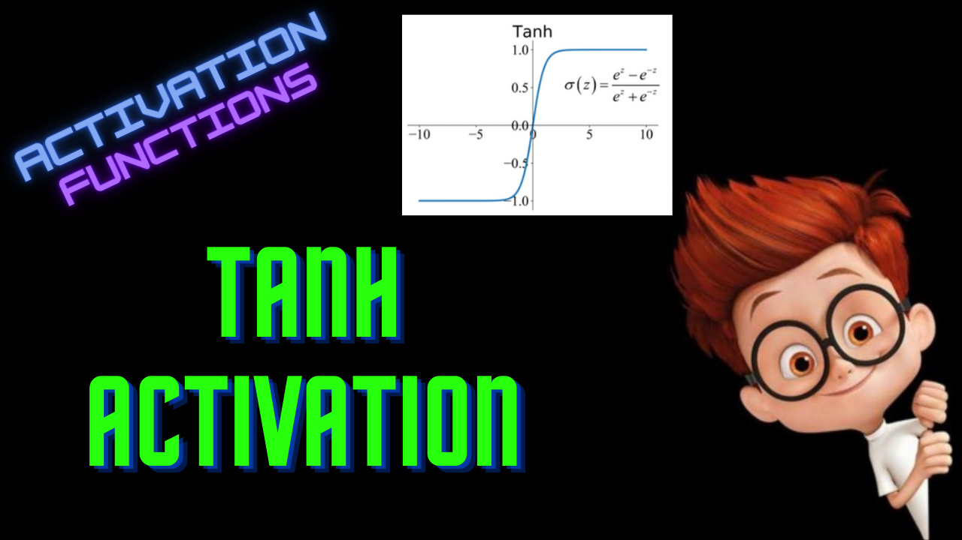

Slide 2
Tanh Activation
ML For Nerds

Slide 3
Drawbacks of Sigmoid
Vanishing Gradient
Not zero-centered
Only for Binary Classification problems

Slide 4
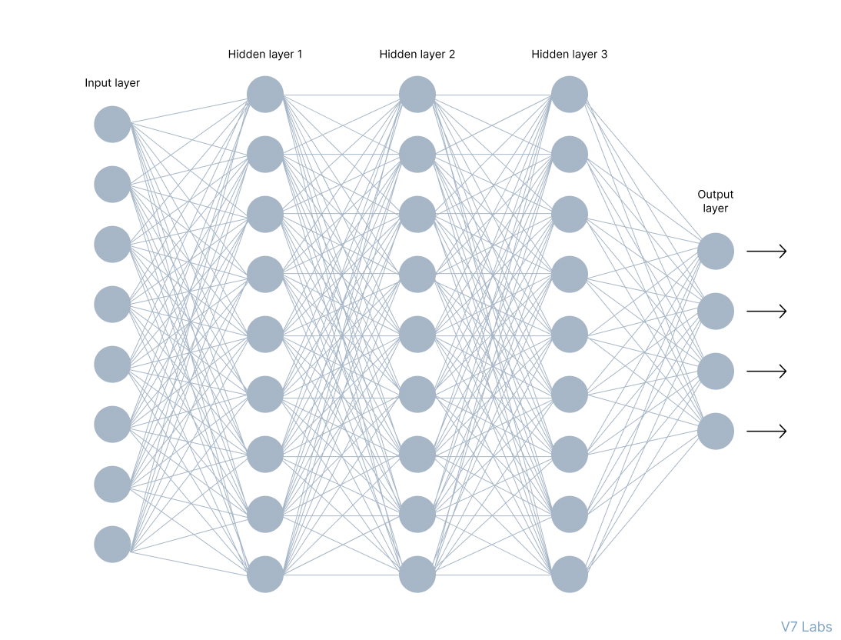
Multi-class problem

Slide 5
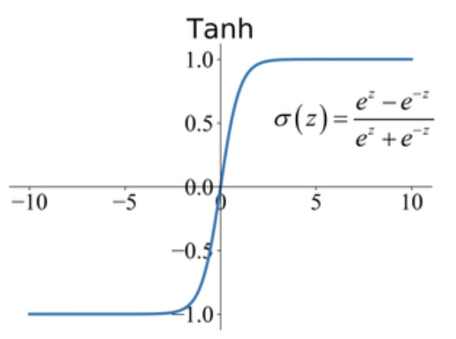

Definition

Slide 6
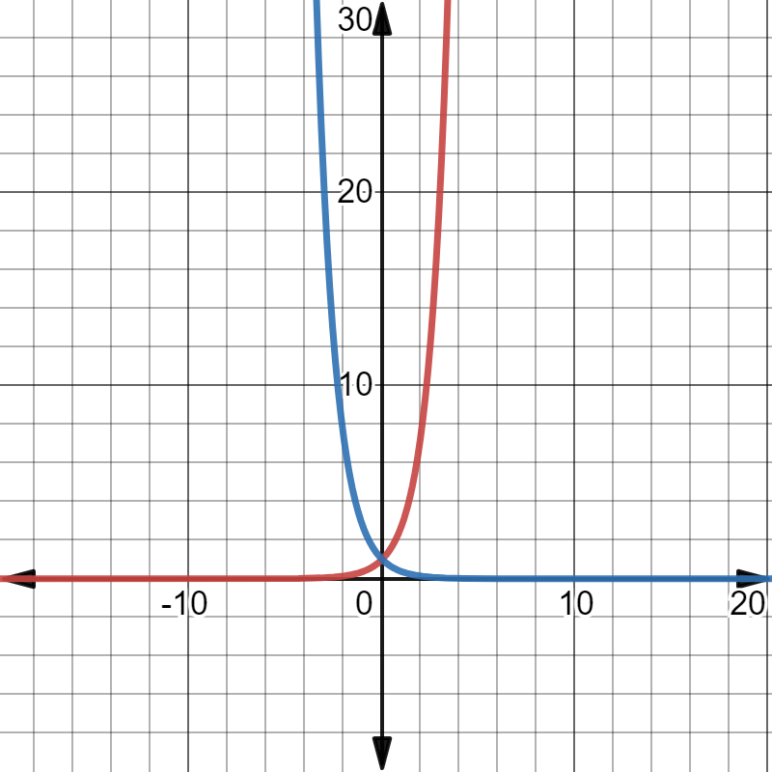
Range
exp(-x)
x | -inf | 0 | inf
exp(x) | 0 | 1 | inf
exp(-x) | inf | 1 | 0
exp(x)

Slide 7
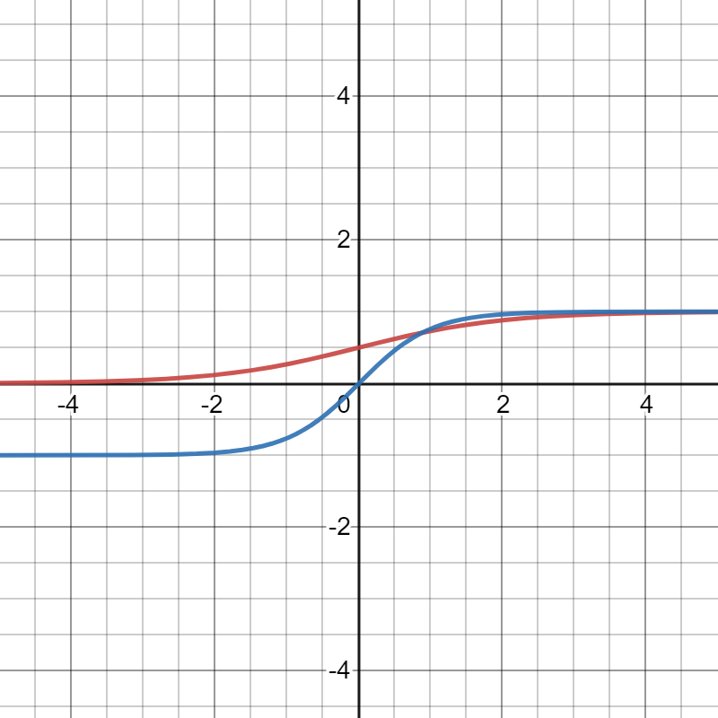
Sigmoid
Tanh

Slide 8
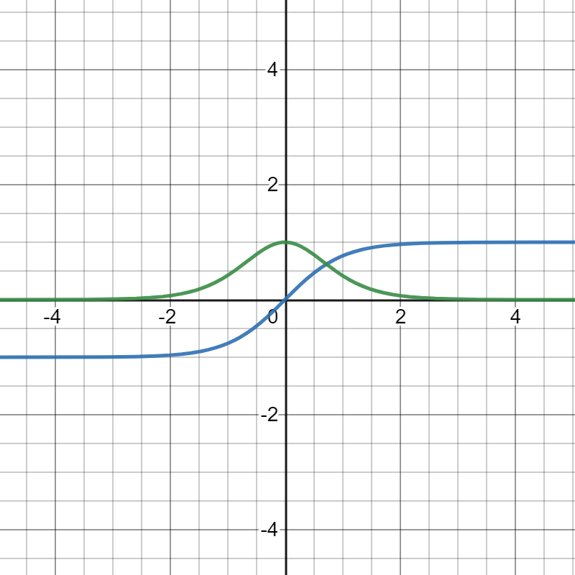

Derivative
f(x)
f’(x)

Slide 9
Drawbacks of Tanh
Vanishing gradient
Only for hidden layers
Computationally expensive

Slide 10

Python Implementation

